Slide 1
Marketing Toolkit Graphics

Slide 2
LinkedIn

Slide 3
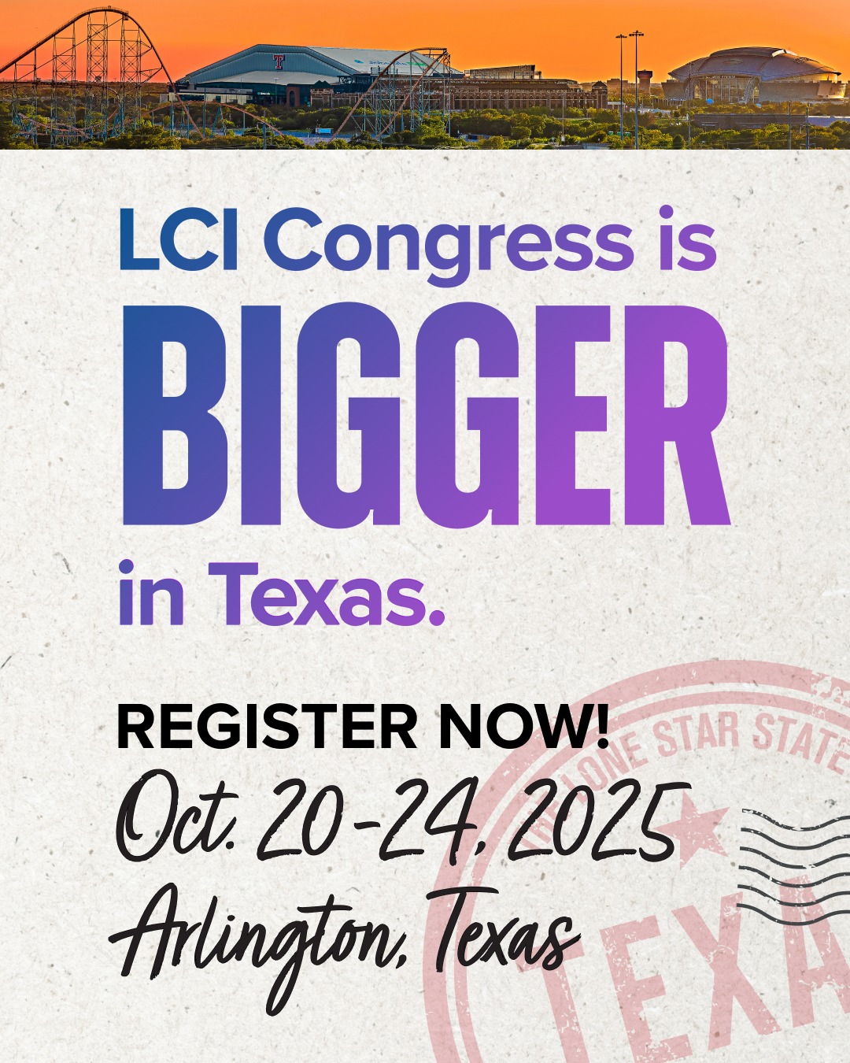
Instagram

Slide 4
Generic Square

